Slide 1
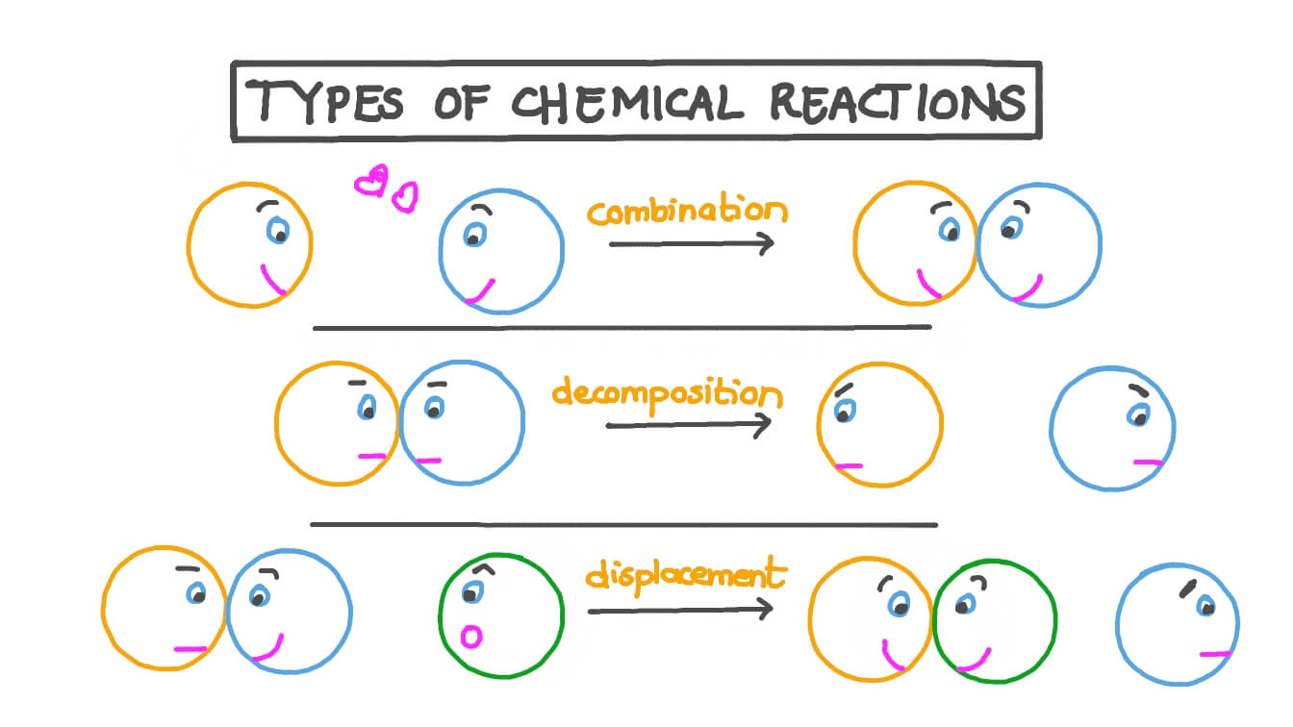
Types of chemical reactions
Al-Farabi Kazakh National University
Higher School of Medicine

Slide 2
LEARNING OUTCOMES
As a result of the lesson you will be able to:
define a chemical reaction;
apply the 3 principles of collision theory to interpret interactions between molecules;
be able to balance chemical equations according to stoichiometric calculations;
determine the reaction rate and factors affecting the reaction rate
identify and define chemical reactions as reactions of combination, decomposition, substitution or combustion,
classify the mechanisms of organic reactions: addition, substitution, radical chain mechanism of halogenation, oxidation-reduction;
predict the probable products of a chemical reaction according to the type of reaction;
write chemical equations for each type of chemical reaction.

Slide 3
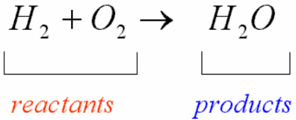
Chemical Reactions and Chemical Equations
A chemical reaction is a process in which one set of substances, called reactants, is converted to a new set of substances, called products.
Features of chemical reactions:
• a color change
• formation of a solid (precipitate) within a clear solution
• evolution of a gas
• evolution or absorption of heat

Slide 4
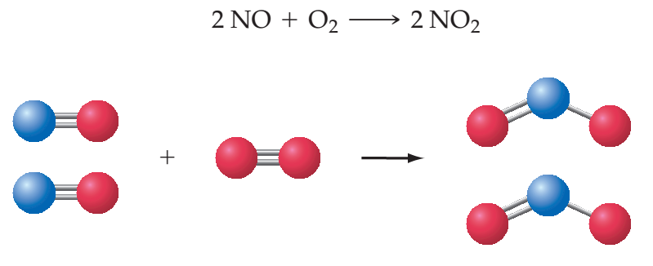
Stoichiometry
In a balanced equation, the total number of atoms of each element present is the same on both sides of the equation.
An equation can be balanced only by adjusting the coefficients of formulas.

Slide 5
What causes a chemical reaction to take place?
Collision theory is a set of statements that give the conditions necessary for a chemical reaction to occur. Central to collision theory are the concepts of:
1. Molecular collisions.
2. Activation energy.
3. Collision orientation.

Slide 6
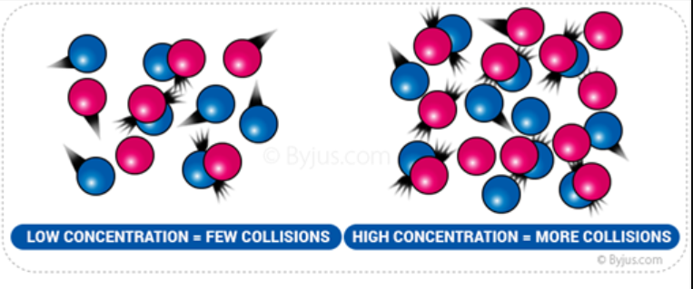
Molecular Collisions
Reactant particles must interact (that is, collide) with one another before any reaction can occur.
When reactions involve two or more reactants, collision theory assumes that the reactant molecules, ions, or atoms must come in contact (collide) with one another in order for any chemical change to occur.

Slide 7
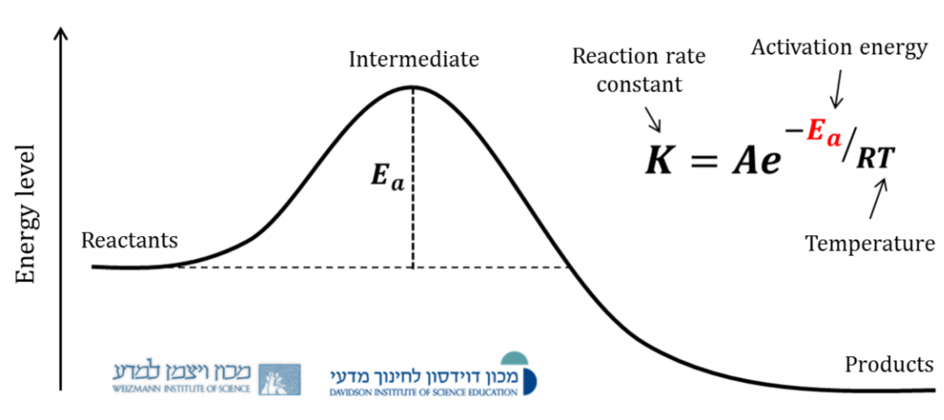
Activation Energy
In order for a reaction to occur, particles must collide with a certain minimum energy; that is, the kinetic energies of the colliding particles must add to a certain minimum value. A certain minimum total amount of energy, called the activation energy (E_{a}).

Slide 8
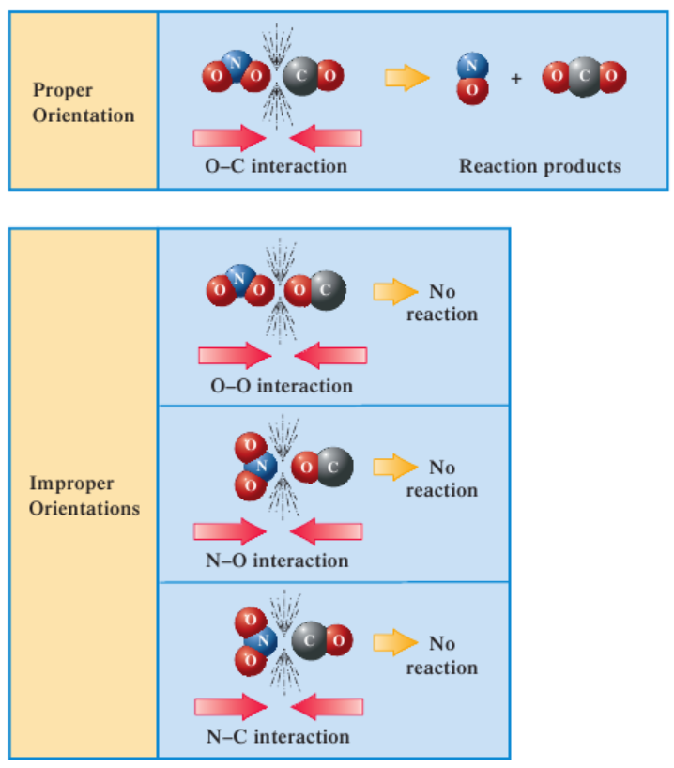
Collision Orientation
Colliding particles must come together in the proper orientation unless the particles involved are single atoms or small, symmetrical molecules.

Slide 9
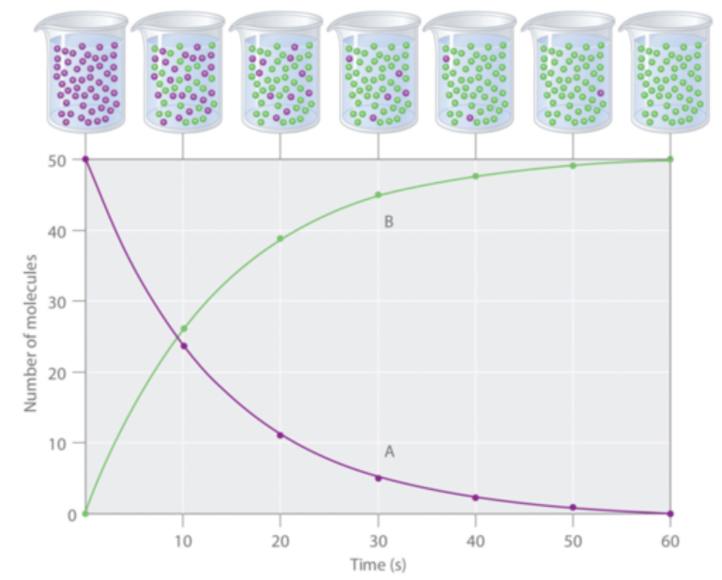
Rate of Reaction
The rate of reaction can be measured by:
measuring how quickly a product is formed
measuring the how quickly a reactant is 'used up'

Slide 10
Factors That Affect Reaction Rate
Temperature
Concentration
Surface Area (Particle Size)
Catalyst

Slide 11
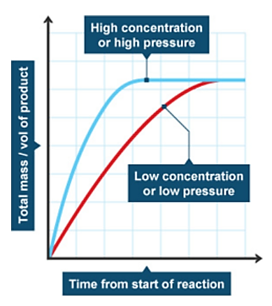
Temperature
Increasing the temperature increases the kinetic energy of the reactant particles. The particles move more quickly increasing the frequency of collisions. The particles also collide with more energy which increases the likelihood of each collision being successful.

Slide 12
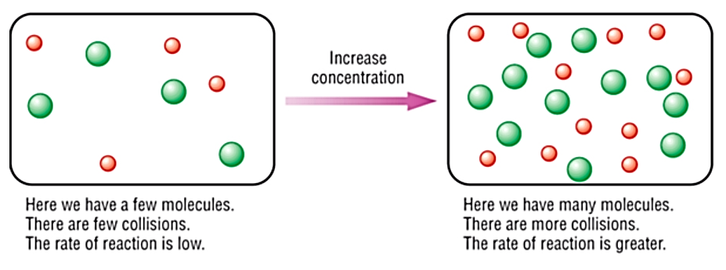
Concentration
Increasing the concentration means there are more reactant particle in a given space (volume). This increases the chance that reactant particles will collide. The increased frequency of collisions results in a faster rate of reaction.

Slide 13
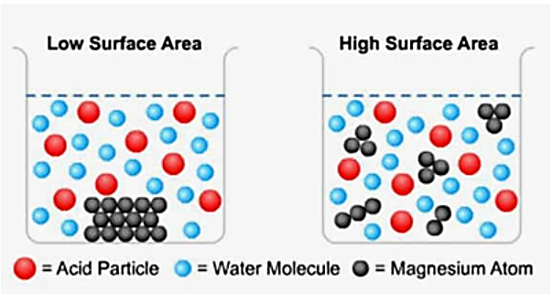
Surface Area / Particle Size
Breaking the reactant into smaller pieces increases the surface and more particles are exposed to the reaction mixture. This results in an increased frequency of collisions and therefore a faster rate of reaction.

Slide 14
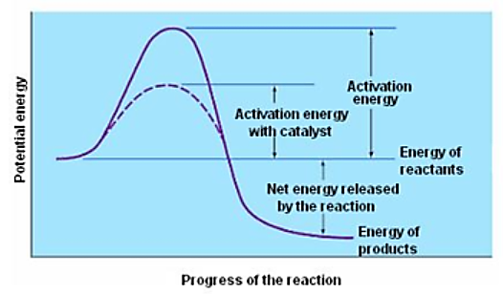
Catalyst
A catalyst is a substance that speeds up a reaction, but is not used up in the process (is not a reactant). Catalysts reduce the activation energy of a reaction. Activation energy is the energy needed to initiate a chemical reaction. A certain level of energy is often needed in order to break existing bond, before new bonds can be formed an energy is released.
A catalyst means that less energy is needed to get the reaction started.

Slide 15
Types of inorganic reactions
A chemical reaction is a process in which at least one new substance is produced as a result of chemical change.
combination reactions,
decomposition reactions,
single-replacement reactions,
double-replacement reactions,
combustion reactions
Acid-base neutralization

Slide 16
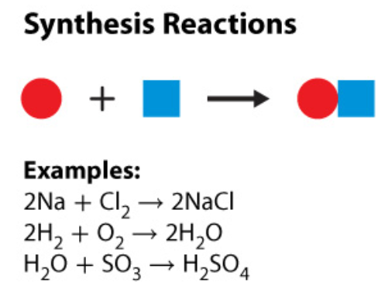
Synthesis
A synthesis is a type of chemical reaction in which two or more substances combine and form one compound.
You can recognize a synthesis reaction because two or more reactants form only one product.

Slide 17
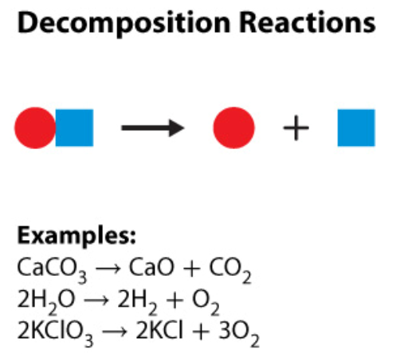
Decomposition
In a decomposition reaction, one compound breaks down and forms two or more substances.
You can recognize a decomposition reaction because one reactant forms two or more products.
Decomposition is the reverse of synthesis.

Slide 18
Replacement
In a replacement reaction, an atom or a group of atoms replaces part of a compound.
•Two types of replacement reactions can occur:
•Single-replacement
•Double-replacement

Slide 19
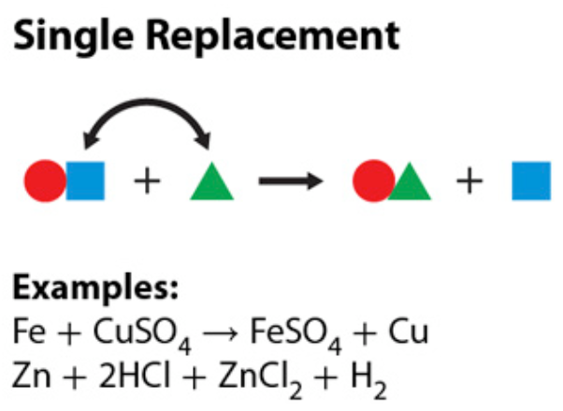
Single-Replacement
In a single-replacement reaction, one element replaces another element in a compound.
In this type of reaction,
an element and a compound
react and form a different
element and a different compound

Slide 20
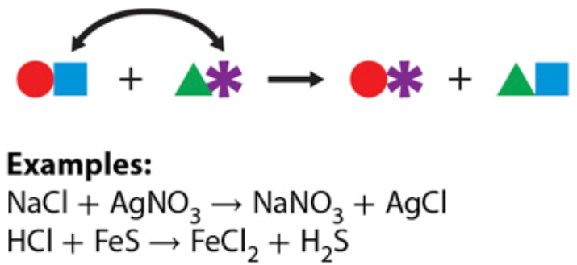
Double-Replacement
In a double-replacement reaction, the negative ions in two compounds switch places, forming two new compounds. In this type of reaction, two compounds react and form two new compounds

Slide 21
Combustion
•Combustion is a chemical reaction in which a substance combines with oxygen and releases energy.
•A combustion reaction usually releases energy as thermal energy and light energy.
•Burning is a common combustion reaction.
•These reactions always produce carbon dioxide and water.

Slide 22
Neutralization
Acid-Base reactions are sometimes called NEUTRALIZATION Reactions because the solution is neither acidic nor basic at the end. The other product of the Acid-Base reaction is a SALT and water.

Slide 23
What Type of Chemical Reaction?
1. In a ______ reaction, the negative ions in two compounds switch places, forming two new compounds.

Slide 24
What Type of Chemical Reaction?
2. In a __________ reaction, one compound breaks down and forms two or more substances.

Slide 25
What Type of Chemical Reaction?
3. In a _________ reaction, a substance combines with oxygen and releases energy.

Slide 26
What Type of Chemical Reaction?
4. 2 C₄H₁₀ + 13 O₂ ------> 8CO₂ + H₂O is an example of a ____________ reaction

Slide 27
What Type of Chemical Reaction?
5. HCl + FeS -----> FeCl₂ + H₂S is an example of a ___________________ reaction.

Slide 28
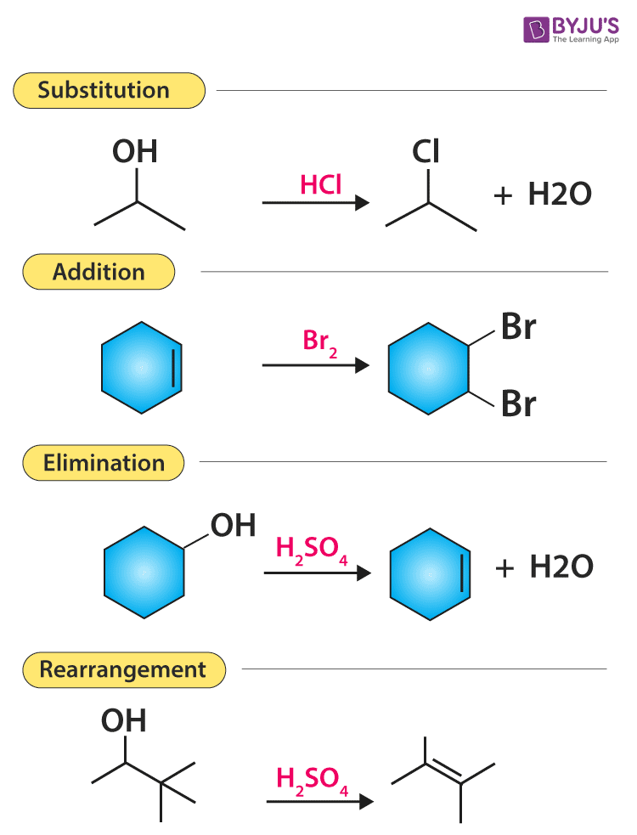
Types of organic reactions

Slide 29
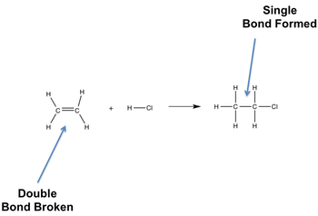
1. Addition reaction
HCl + CH2 = CH2 → CH3CH2Cl
Instead of H-Cl could be: H₂, Cl₂, F₂, Br₂, I₂, H₂O, HBr, HI etc.

Slide 30
2. Elimination reaction

Slide 31
3. Substitution reaction
OH⁻ + CH₃Cl → CH₃OH + Cl⁻

Slide 32
4. Radical reactions

Slide 33
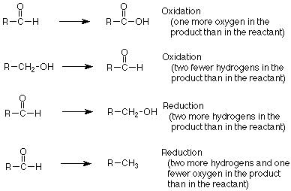
5. Oxidation-Reduction reactions

Slide 34
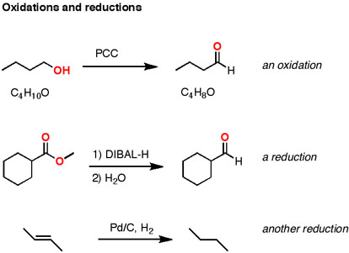
Oxidation-Reduction reactions examples

Slide 35
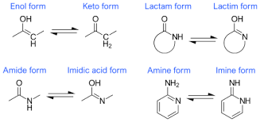
6. Rearrangements
(often happens, however not actually a type of organic reactions)

Slide 36
We discussed today…
define a chemical reaction;
apply the 3 principles of collision theory to interpret interactions between molecules;
be able to balance chemical equations according to stoichiometric calculations;
determine the reaction rate and factors affecting the reaction rate
identify and define chemical reactions as reactions of combination, decomposition, substitution or combustion,
classify the mechanisms of organic reactions: addition, substitution, radical chain mechanism of halogenation, oxidation-reduction;
predict the probable products of a chemical reaction according to the type of reaction;
write chemical equations for each type of chemical reaction.

